Slide 1
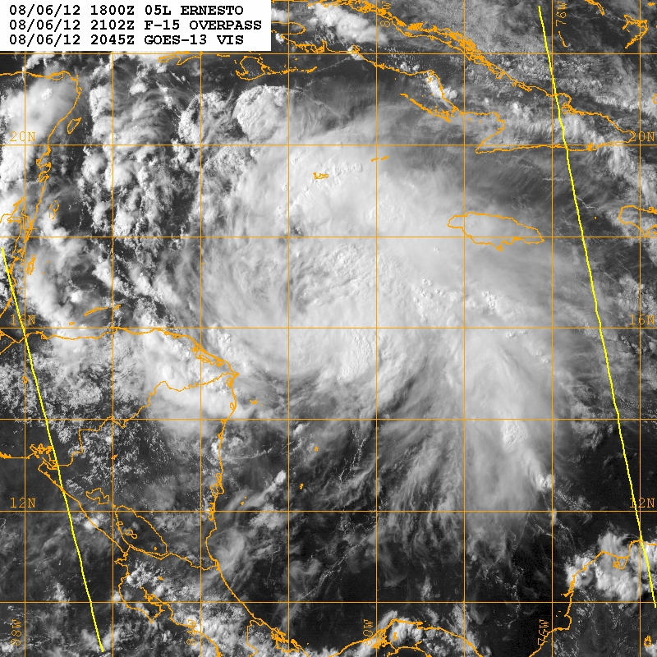
COAMPS‐TC Diagnostics
Yi Jin, Jon Moskaitis, Hao Jin, James D. Doyle
Naval Research Laboratory, Monterey, CA
In collaboration with
M. DeMaria, K. Musgrave, L. Grasso, and D. Zelinsky
through HFIP
TC Ernesto (05L) 1800 UTC August 2012

Slide 2
COAMPS-TC Diagnostic Recent Activities
Improved implementation of diagnostic code in COAMPS-TC:
Switched to the CIRA database for the land-sea table
Corrected an inconsistency in 200-hPa divergence calculation
Updated the in-line documentation of the diagnostic code
Provided feedback to ADD team
Provided HTCF data for sample storms:
Collaborated with NHC for a set of test storms
Designed new methods to examine high-frequency convective activities around TC
Work under way to generate HTCF data in real time:
Implementing code in the COAMPS-TC real-time version
2-3% overhead for HTCF calculation and output
New COAMPS-TC diagnostic capabilities:
Characterization of track errors according to initial time position and intensity
Application of diagnostic fields for better understanding of track and intensity forecast errors

Slide 3
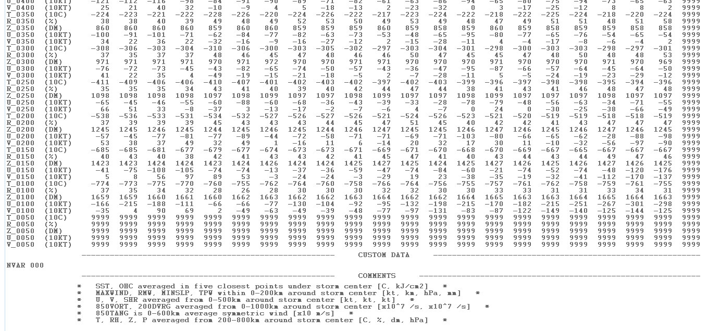
COAMPS-TC Diagnostic (I) Ernesto 200-hPa Divergence
Sample data
850VORT, 200DVRG averaged from 0-1000 km around storm center
200-1000 km (correct)
Corrected this inconsistency and communicated with the ADD team leader
Provided feedback on other issues with the diagnostic code in-line documentation

Slide 4
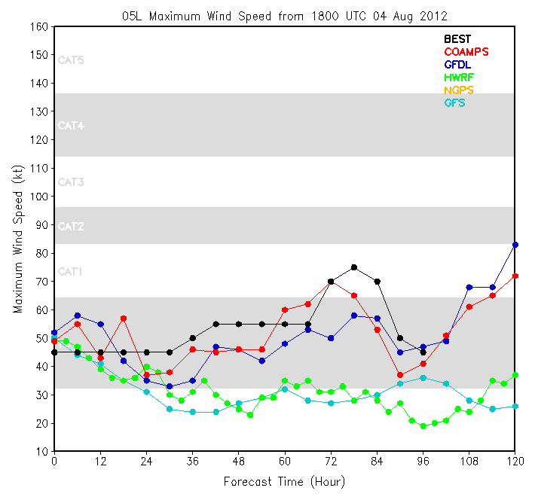
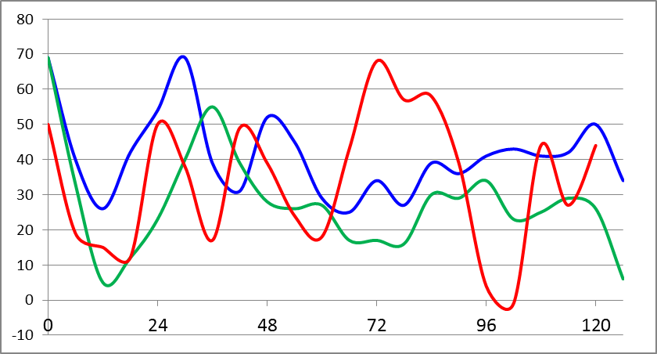
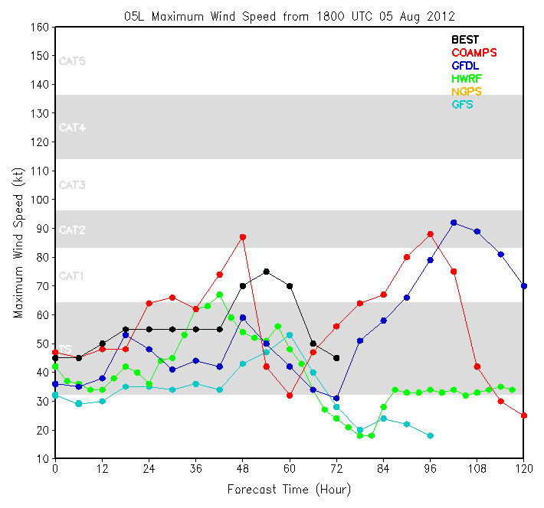
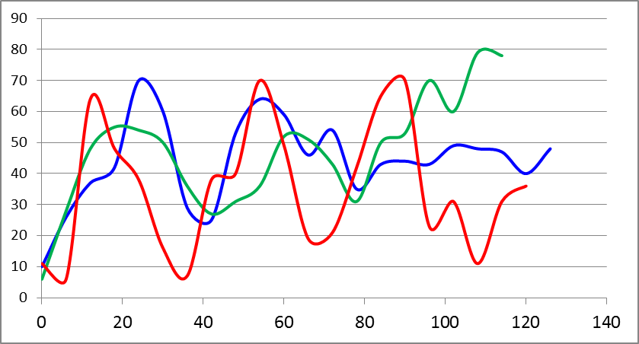
COAMPS-TC Diagnostic (II) Ernesto 200-hPa Divergence
Initialized at 2012080418
COAMPS-TC
GFDL
HWRF
BEST
10-⁷ s⁻¹
Initialized at 2012080518
10-⁷ s⁻¹
COAMPS-TC upper level divergence is in line with GFDL and HWRF

Slide 5
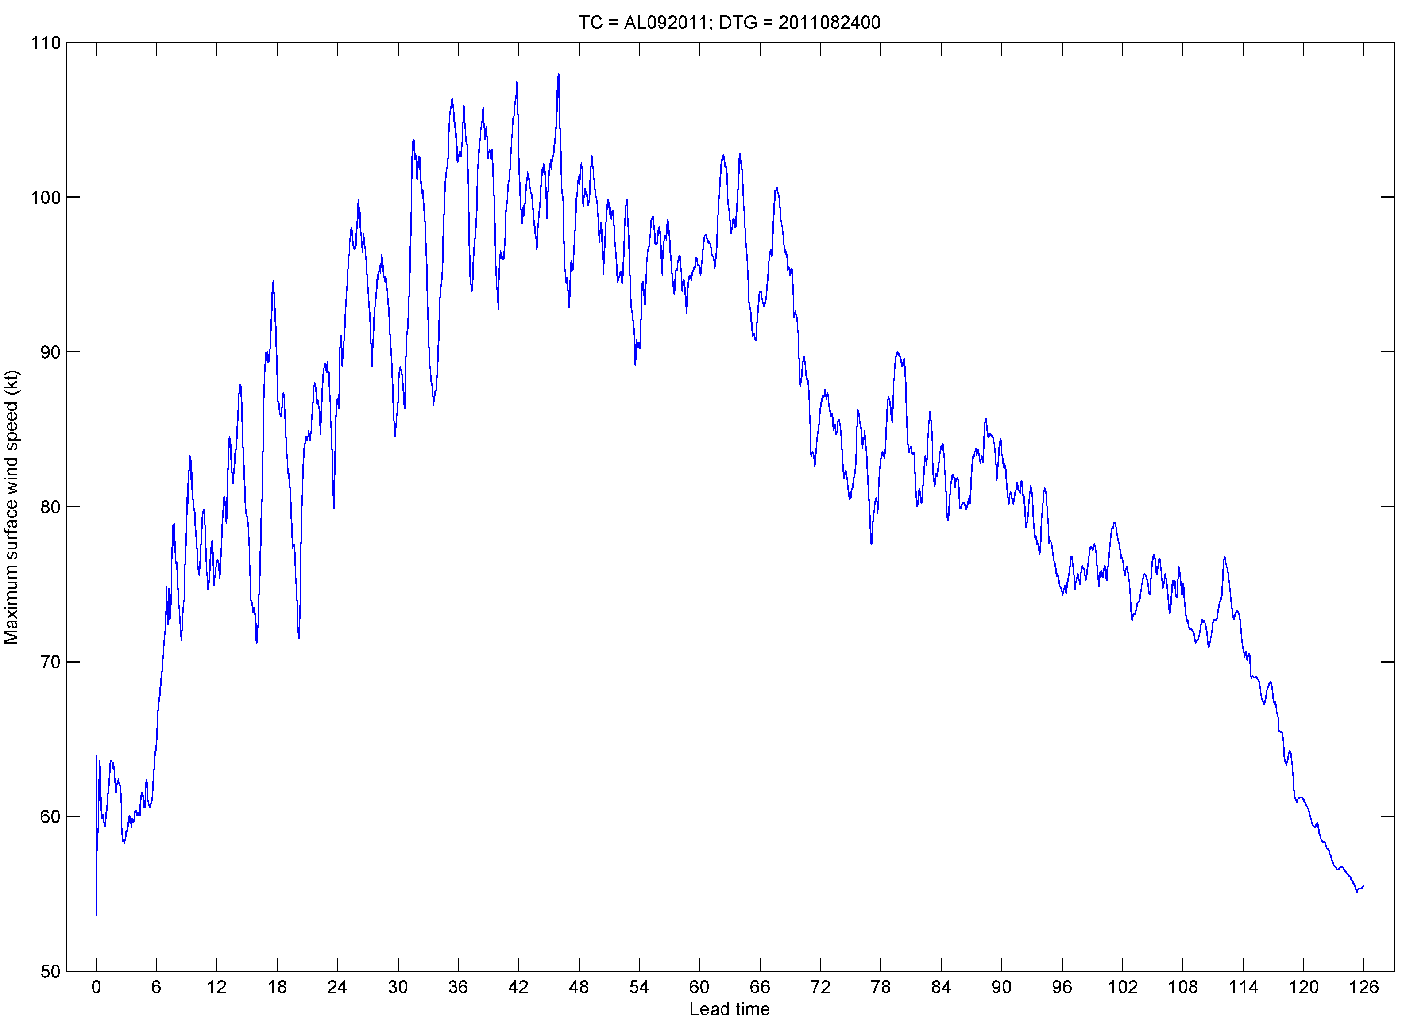
COAMPS-TC High-frequency TC model output (HTCF)
COAMPS-TC intensity prediction for Irene, initial time = 2011082400
Maximum surface wind speed (kt)
Lead time (h)

Slide 6
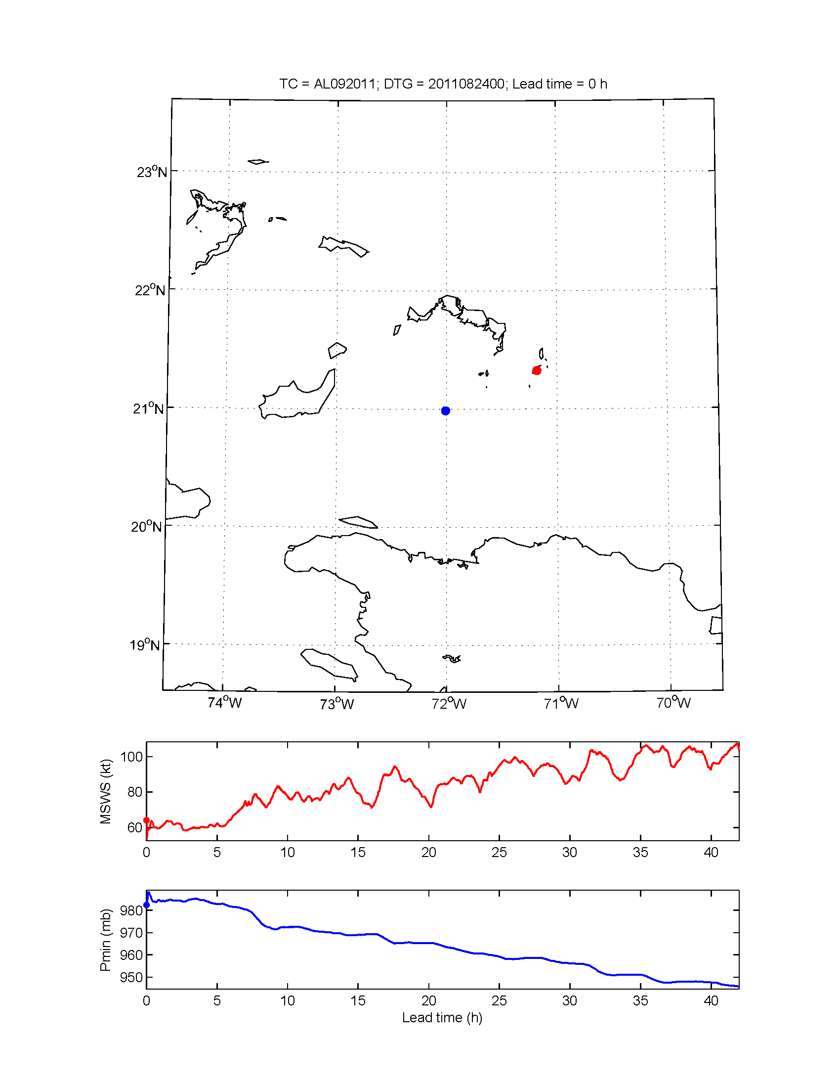
COAMPS-TC High-frequency TC model output (HTCF)
COAMPS-TC Irene forecast
Initial time : 2010082400
Lead times : 0 – 42 h
Frame interval : 15 min
Blue dot: Location of sea-level pressure
minimum
Red dot: Location of surface wind speed
maximum
Maximum surface wind
speed time series
Minimum sea-level
pressure time series

Slide 7
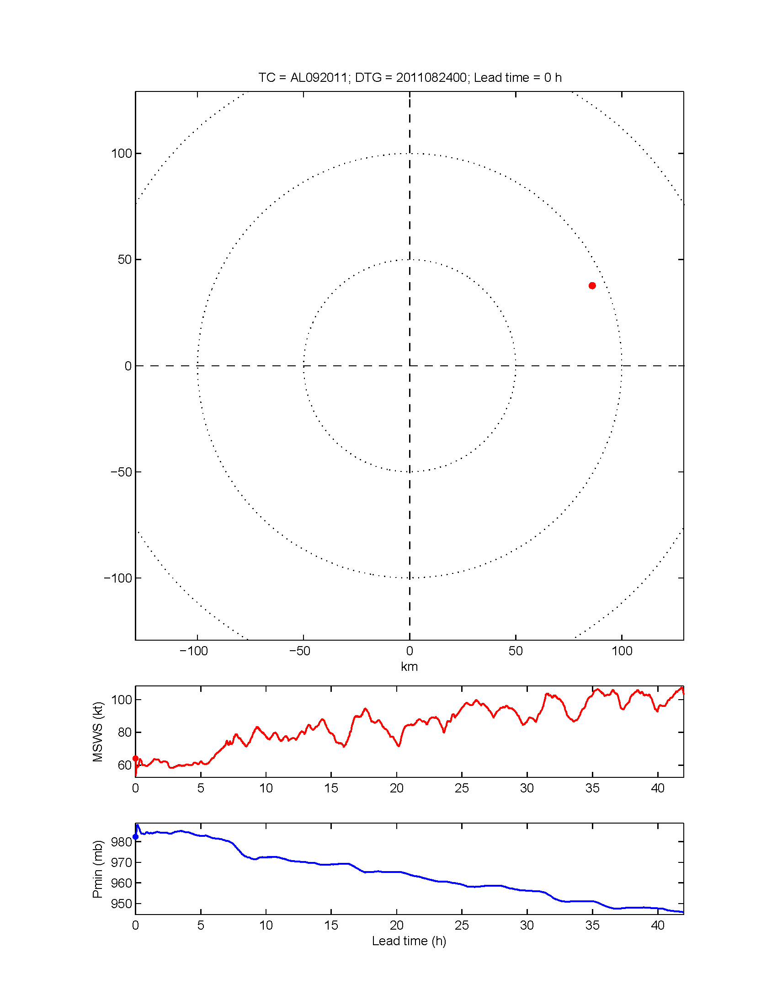
COAMPS-TC High-frequency TC model output (HTCF)
COAMPS-TC Irene forecast
Initial time : 2010082400
Lead times : 0 – 42 h
Frame interval : 15 min
Red dot: Location of surface wind speed
maximum, relative to the storm
center (slp minimum)
Maximum surface wind
speed time series
Minimum sea-level
pressure time series

Slide 8
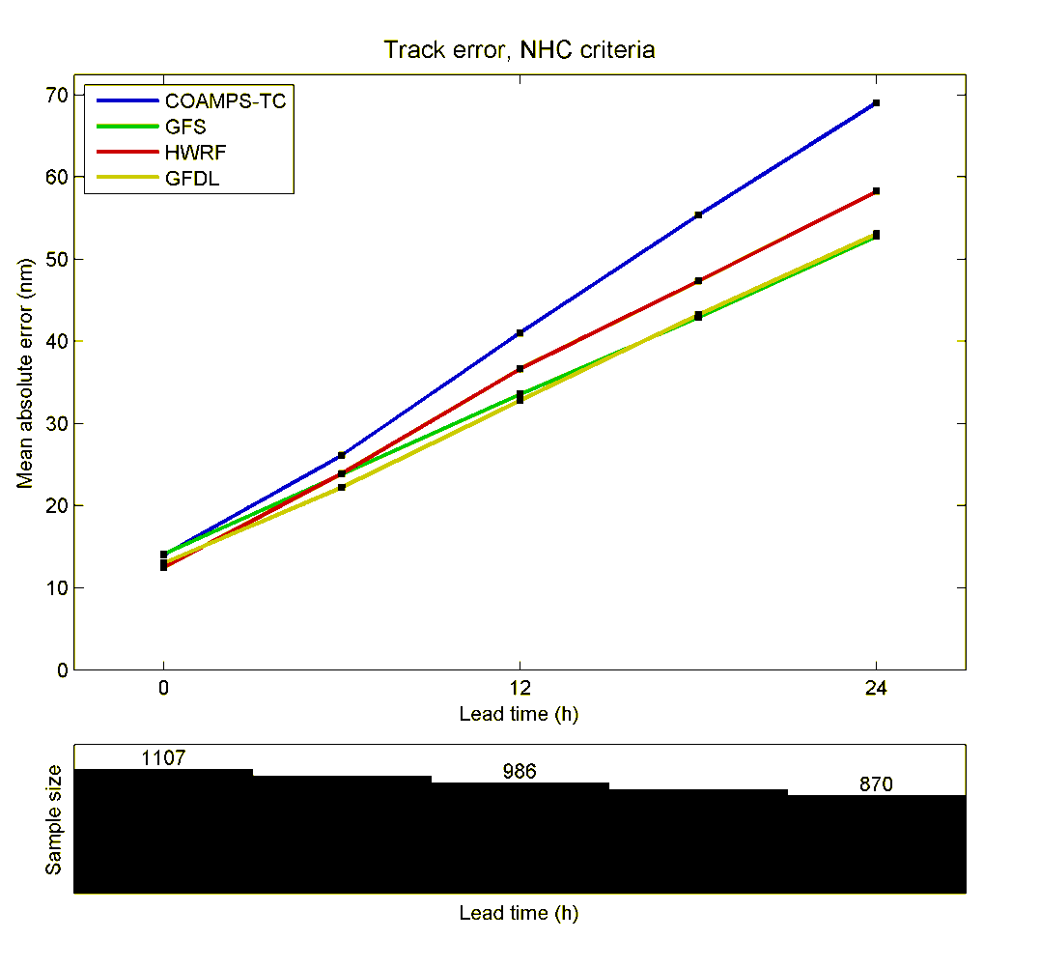
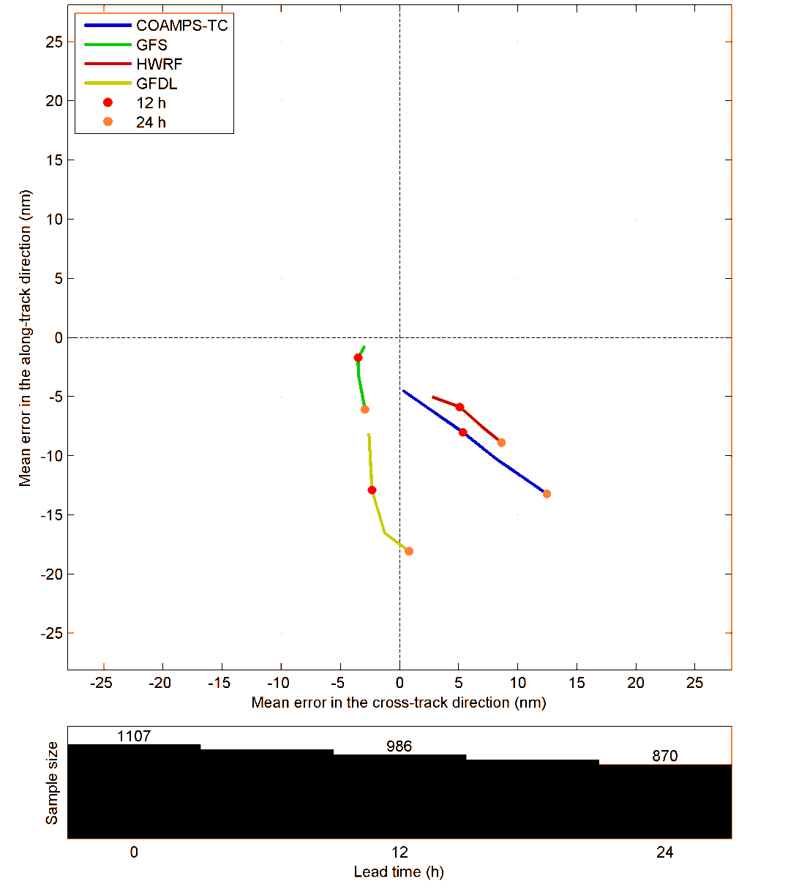
Short-range track forecast verification
Mean absolute error
Mean error in storm-relative coordinates
Ahead
Left
Right
Behind
COAMPS-TC: 2012 HFIP retro runs (2009-2011, AL + EP)
GFS, HWRF, GFDL: Operational forecasts from a-decks
All 4 models are ‘behind’ the observed position, on average, but cross-track bias differs
COAMPS-TC has the highest track MAE

Slide 9
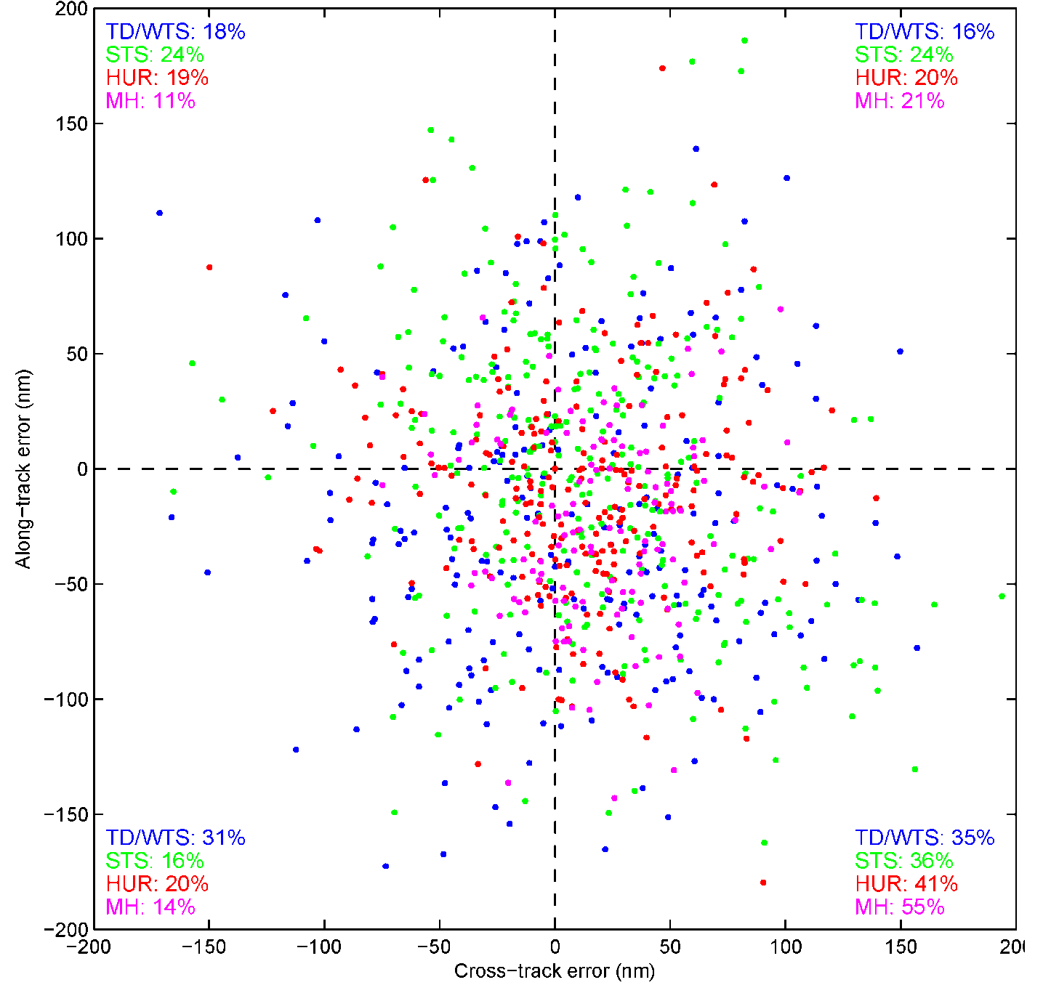
Short-range track forecast verification
COAMPS-TC
Scatter of 24 h COAMPS-TC track errors in storm-relative coordinates,
stratified by best-track initial intensity (colors)
Overall: 19%
Overall: 20%
“Slow/right” has the highest relative frequency of the 4 quadrants for all initial intensity categories
The stronger the initial intensity, the more likely the 24-h track error is slow/right
Ahead
Overall: 21%
Overall: 40%
Left
Right
Behind

Slide 10
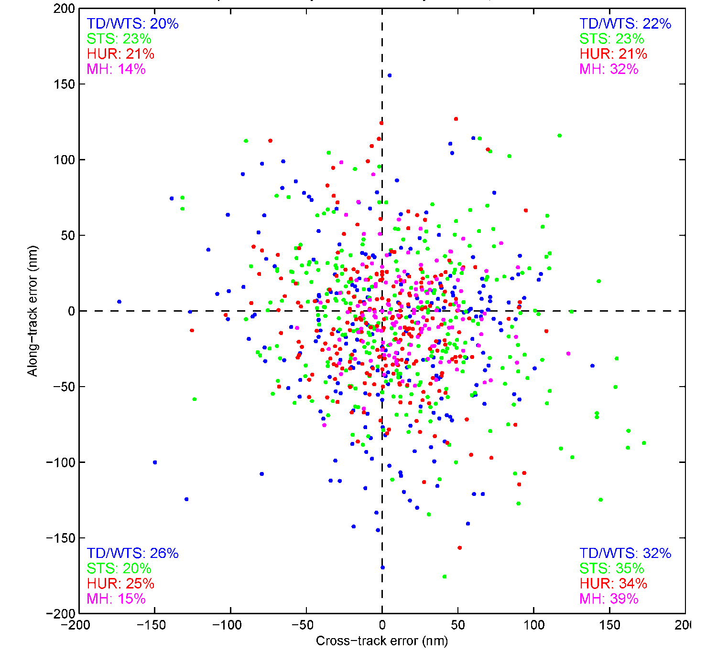
Short-range track forecast verification
ops HWRF
Scatter of 24 h ops HWRF track errors in storm-relative coordinates,
stratified by best-track initial intensity (colors)
Overall: 20%
Overall: 23%
Like COAMPS-TC, HWRF errors are most often in the slow/right quadrant
Right bias for major
hurricanes
Ahead
Overall: 22%
Overall: 35%
Left
Right
Behind

Slide 11
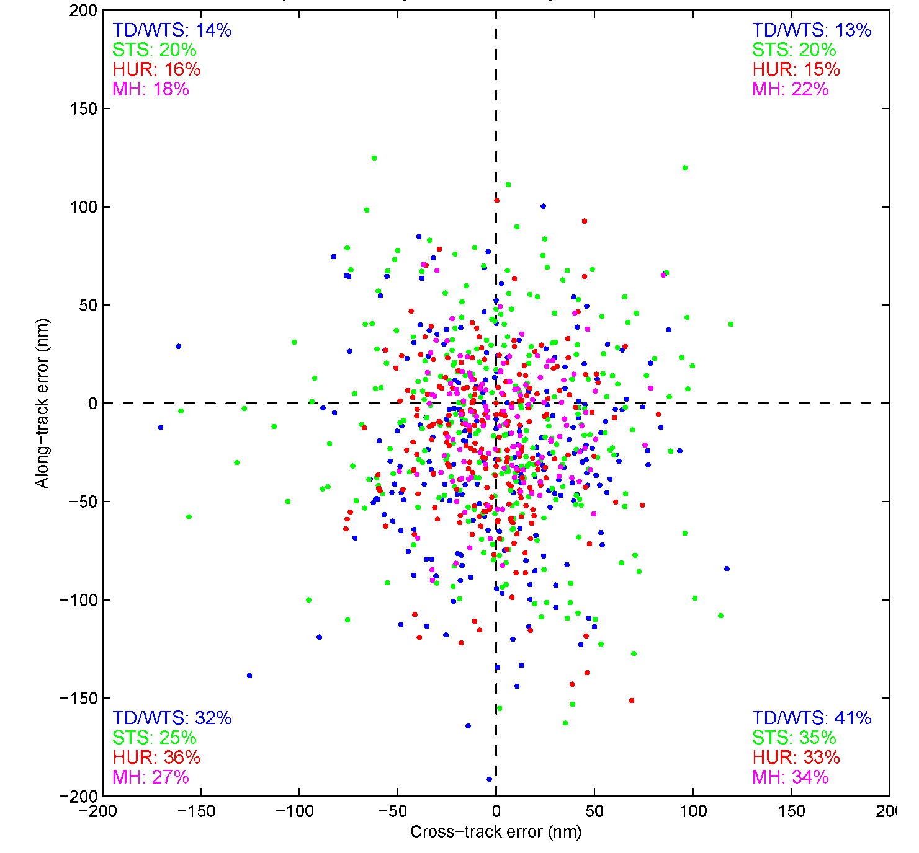
Short-range track forecast verification
Ops GFDL
Scatter of 24 h ops GFDL track errors in storm-relative coordinates,
stratified by best-track initial intensity (colors)
Overall: 17%
Overall: 17%
GFDL has high relative frequencies for slow/right and slow/left, especially for the weakest TCs
Ahead
Overall: 30%
Overall: 36%
Left
Right
Behind

Slide 12
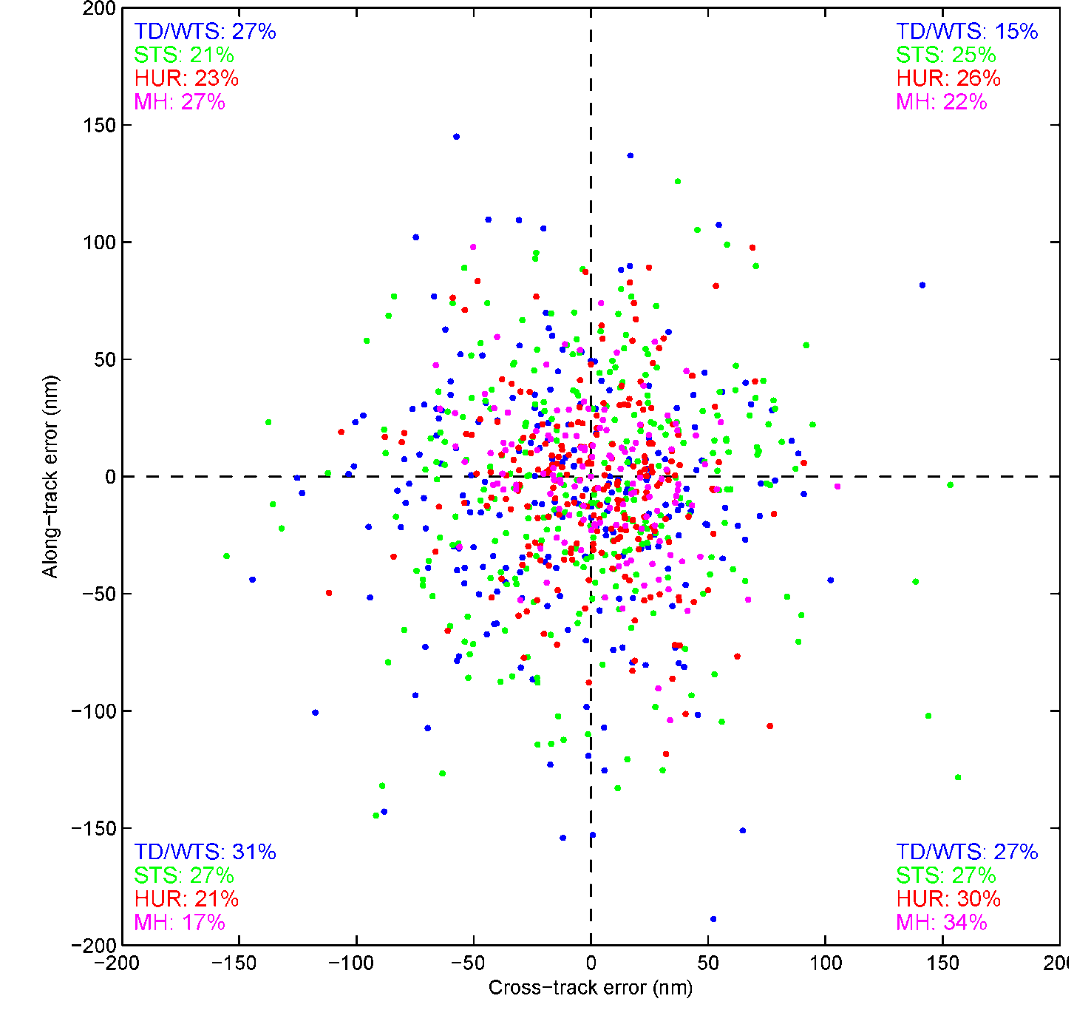
Short-range track forecast verification
Ops GFS
Scatter of 24 h ops GFS track errors in storm-relative coordinates,
stratified by best-track initial intensity (colors)
Overall: 24%
Overall: 22%
GFS has the most evenly
distributed track errors.
Still, slow/right has the
highest relative frequency
amongst the four
quadrants
Ahead
Overall: 25%
Overall: 29%
Left
Right
Behind

Slide 13
Short-range track forecast verification
Scatter of best-track positions at forecast initial time, color/size denotes COAMPS-TC 24 h forecast track error characteristics
Ahead
Left
Right
Behind
Dot size ~ track error magnitude
COAMPS-TC tracks are consistently slow/left in the eastern tropical Atlantic and slow/right in the central tropical Atlantic. Errors also tend to be largest in these regions.

Slide 14
Short-range track forecast verification
Scatter of best-track positions at forecast initial time, color/size denotes ops HWRF 24 h forecast track error characteristics
Ahead
Left
Right
Behind
Dot size ~ track error magnitude
Like COAMPS-TC, HWRF tends to be slow/right in the central tropical Atlantic
and has some of its largest errors in that region

Slide 15
Short-range track forecast verification
Scatter of best-track positions at forecast initial time, color/size denotes ops GFDL 24 h forecast track error characteristics
Ahead
Left
Right
Behind
Dot size ~ track error magnitude
GFDL is slow everywhere

Slide 16
Short-range track forecast verification
Scatter of best-track positions at forecast initial time, color/size denotes ops GFS 24 h forecast track error characteristics
Ahead
Left
Right
Behind
Dot size ~ track error magnitude
GFS has noticeably smaller errors than the regional models in the NW Atlantic

Slide 17
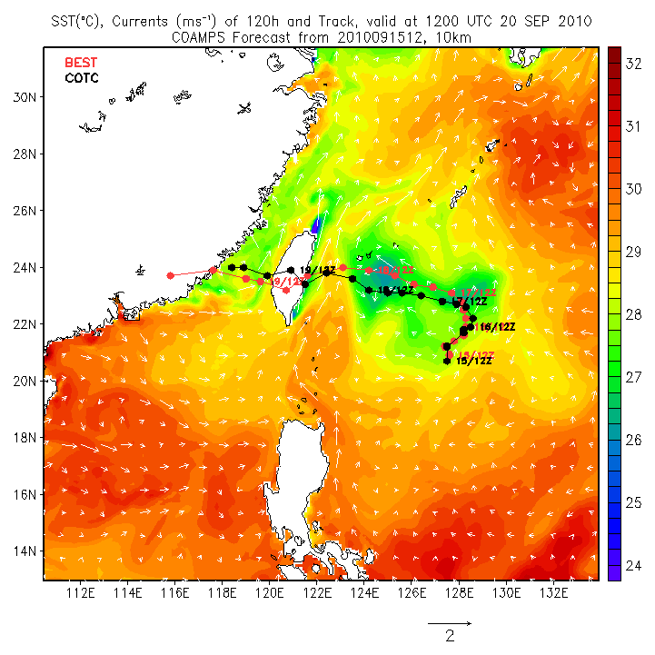
Application of Diagnostic Fields (I)
Typhoon Fanapi Initialized at 1200 UTC 15 Sep 2010
COAMPS-TC successfully predicted Typhoon Fanapi’s track in support of 2010 ITOP field experiment

Slide 18
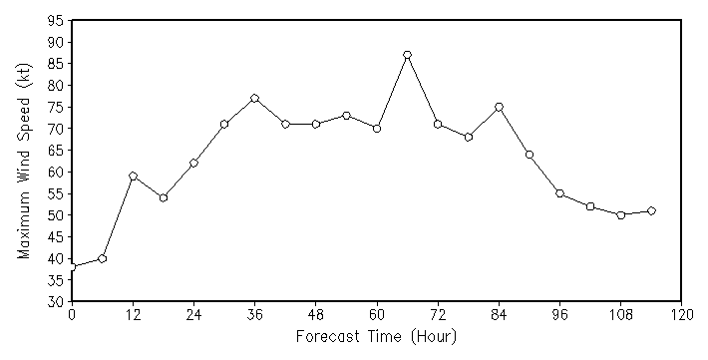
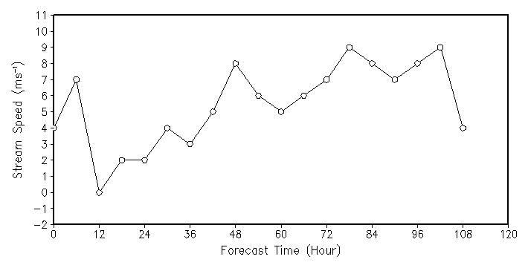
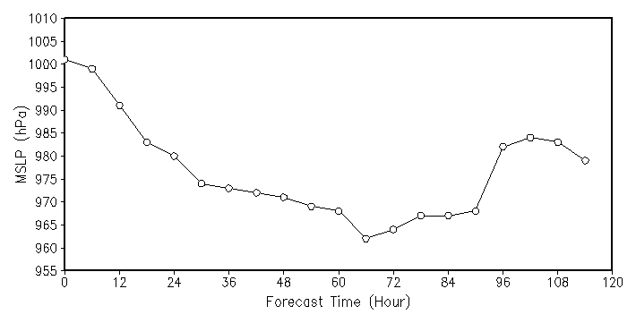
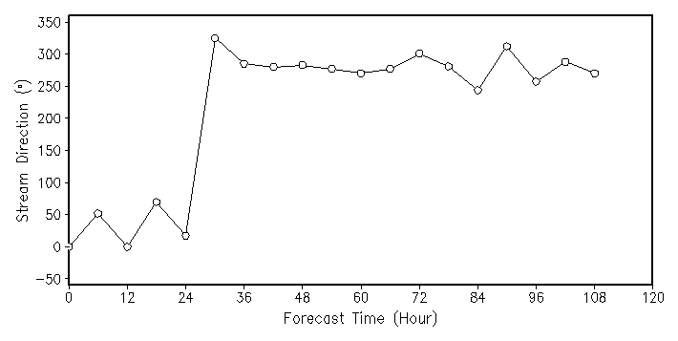
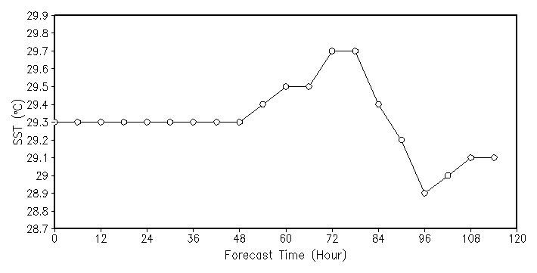
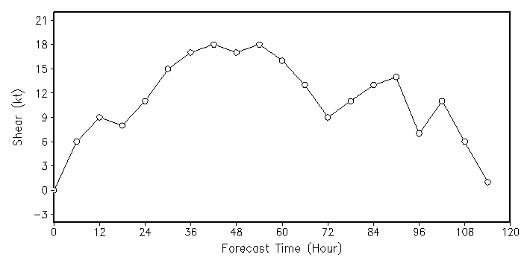
Application of Diagnostic Fields (II)
Typhoon Fanapi diagnostic fields
Environmental flow speed (500 km averaged)
Maximum Wind
MSLP
Environmental flow direction
SST
29º
Environment Shear (200-850 hPa)
Fanapi intensified as it moved over warm SST
The sharp turn in the storm track from northward to westward is associated with the sudden change in the environmental flow direction

Slide 19
COAMPS-TC Diagnostic Plans and Thoughts
Continue collaboration with ADD team
Provide diagnostic data for 2012 storms
Work with CIRA for synthetic satellite imagery
Continue work with NHC on HTCF code implementation for real-time forecasts
Test thoroughly before transitioning the code
Develop and apply new methods
Understand the mechanisms responsible for short-term track errors
Continue to diagnose and improve system
Work closely with our customers
Notes:
adjoint allows for the mathematically rigorous calculation of sensitivity to changes in the initial state

